Slide 1
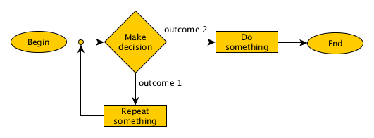
What is a problem?
A problem is a puzzle that requires logical thought or mathematics to solve it.
-Taken from Collins Dictionary(https://www.collinsdictionary.com/dictionary/english/problem )
In this presentation we only talk about the problems that are solved by using algorithms.
Figure 1.1

Slide 2

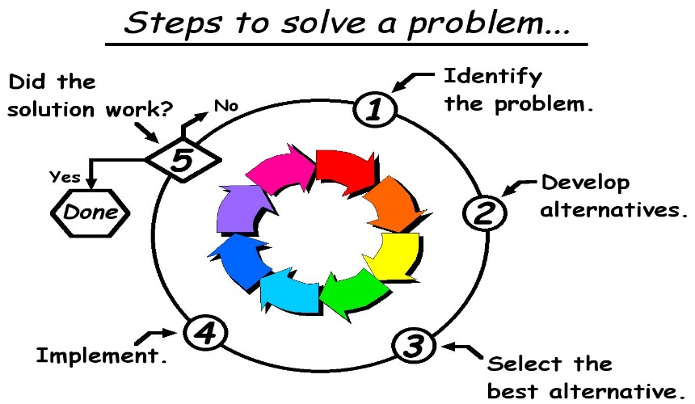
HOW TO SOLVE A PROBLEM
Identify the problem.
Make some hypothesizes
Test those hypothesizes and note down the results of them
Analyze the results
Arriving to a conclusion.

Slide 3
Figure 1.1 - https://www.bing.com/images/search?view=detailV2&ccid=3FS7tEUg&id=8186F0443B0AAEB2F60095945A25E88217B08EC3&thid=OIP.3FS7tEUgtHtTU2kPiPwliQHaCu&mediaurl=https%3A%2F%2Fwww.c-programming-simple-steps.com%2Fimages%2Fbranched-cyclic-algorithm.png&exph=196&expw=531&q=simple+algorithm&simid=607985979248283457&selectedindex=10&ajaxhist=0&vt=0&sim=11
Fig 2.1-https://www.bing.com/images/search?view=detailV2&id=FA9AD81452FB2898C00271221EEC5FCB6C95F1CF&thid=OIP.OyDO3-aiZDSuOhTXn-PMrwHaFT&mediaurl=http%3A%2F%2F1.bp.blogspot.com%2F-NQdEJekT3Kk%2FUUK7kR5UigI%2FAAAAAAAAIUM%2FJUTv0ypNit4%2Fs1600%2Fproblem_solving-n13tg0.jpg&exph=978&expw=1364&q=how+to+solve+a+problem&selectedindex=10&ajaxhist=0&vt=0&eim=0,1,2,3,4,6,8,10
Fig 2.2-https://www.bing.com/images/search?view=detailV2&id=FA0CD6F0040F95262AD0A00685A7C9A311A3A431&thid=OIP.zJ7FJaeYwqy4gM6kKGJ6nwHaEv&mediaurl=https%3A%2F%2Finnovateuk.blog.gov.uk%2Fwp-content%2Fuploads%2Fsites%2F153%2F2017%2F07%2FProblem-solving-620-620x397.jpg&exph=397&expw=620&q=how+to+solve+a+problem&selectedindex=8&ajaxhist=0&vt=0&eim=0,1,2,3,4,6,8,10

